Slide 1
Assessment of Speckle‑Pattern Quality using Deep‑Learning‑Based CNN
Paper by - T.H. Kwon, J. Park, H. Jeong, K. Park
Presentation by – Divyansh Sagar (MTech)

Slide 2
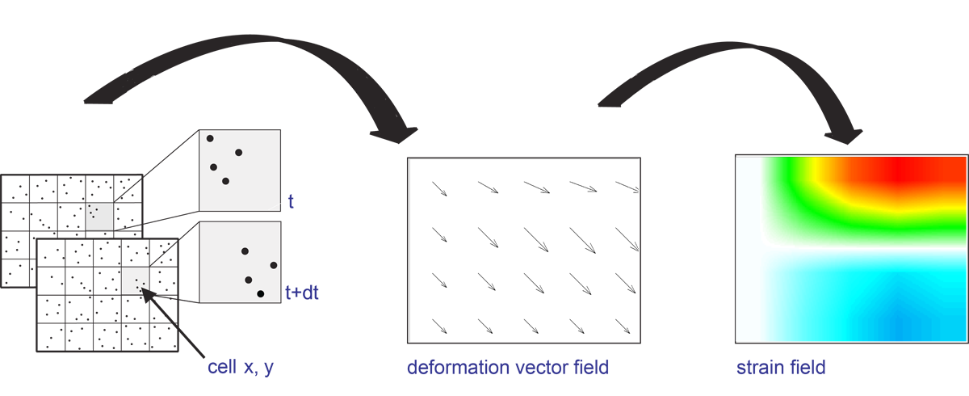
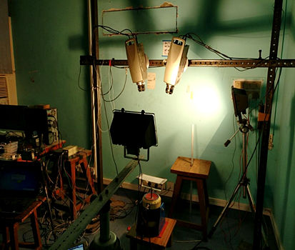
INTRODUCTION
Digital image correlation (DIC) is a non-contact surface measurement technique used for deformation measurements.
It is generally done in three steps
First, a speckle patter is generated using a nozzle
High-quality speckle patterns are important for successful DIC assessments.
Second, the reference and deformed photos are taken using a high quality camera.
Third, the image is analyzed for displacement or strain fields.
Fig1. Digital Image Correlation
Fig2. DIC setup

Slide 3
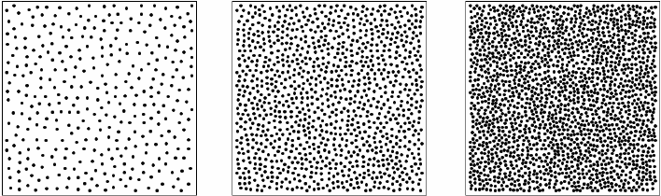
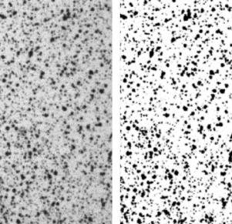
BACKGROUND
In DIC, error is related to several factors such as speckle pattern, image acquisition, systematic procedure and experimental environment.
Specially speckle pattern can have huge impact on the error.
Qualities required in good speckle pattern are,
high contrast among large grayscale intensity gradients,
randomness on non-periodic and nonrepetitive patterns,
isotropy of directionality in a pattern, and stability of tight attachment to a sample surface.
Several attempts have been made to asses the quality of speckle pattern.
sum of square of subset intensity gradients (SSSIG) metric, mean intensity gradient (MIG), mean subset fluctuation (MSF) are a few examples.
Fig3. Three different speckle patterns with a speckle diameter of 5 pixels and a coverage of 10% (left), 30% (middle) and 50% (right)
Fig4. Speckle pattern

Slide 4
AUTHOR’S OBJECTIVES
Finding a New method to assess speckle pattern using CNN without any pre – existing qualitative knowledge.
CNN will account for unknown(or uncovered) features of speckle pattern.

Slide 5
METHODOLOGY
15 speckle patterns were generated.
Nozzle size – 0.2, 0.5, 0.8, 1.0 and 1.2 mm
Spraying time – short, intermediate, long.
3000x3000 size of original images cut into various smaller size for training data.
150×150, 200×200, 250×250, 300×300, 500×500, 800×800, 1000×1000, and 1500 × 1500
Total 13,905 images were created for data set.
Fig.5 Fifteen cases of speckle patterns with different nozzle sizes
and spraying times

Slide 6
METHODOLOGY (Displacement field)
3 cases of synthetic displacement field was generated. Uniaxial compression, Bending, mode 1 crack.
Fig.6 Synthetic displacement field of the three-point bending displacement field along the horizontal(left) and vertical(right) directions within 1500 × 1500 pixel
Fig.7 Mode-I crack tip synthetic displacement field along the horizontal(left) and vertical(right) directions within 1500×1500 pixel

Slide 7
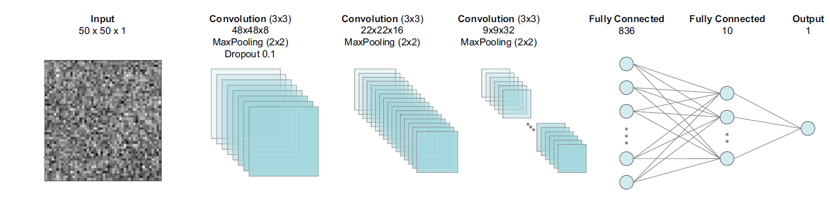
CONVOLUTIONAL NEURAL NETWORK
CNN’s are specifically designed to assist with pattern recognition and image recognition.
The CNN model used by the author is given below.
Fig.8 Schematic view of the CNN architecture

Slide 8
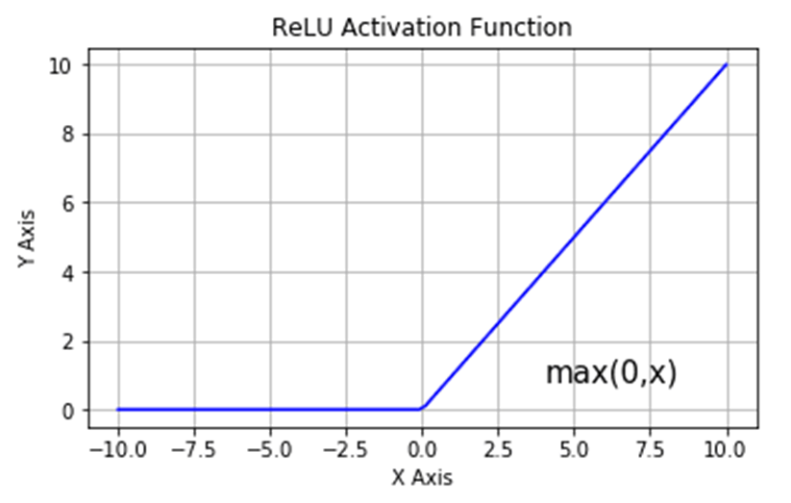
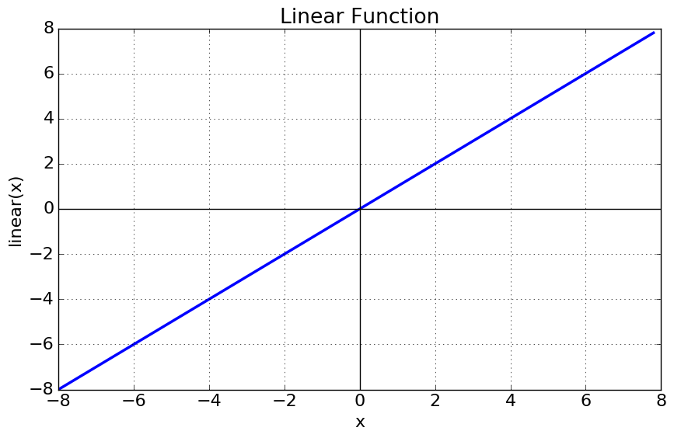
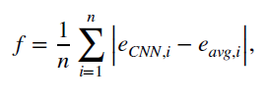
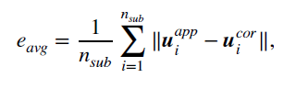
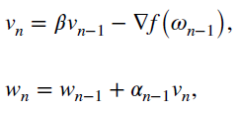
TRAINING ALGORITHM
2 activation functions used in the algorithm.
Fig. 9&10 plots of ReLu and linear activation function
Mean absolute error function is used as an objective function.
Stochastic gradient decent function is used to minimise the objective function.

Slide 9
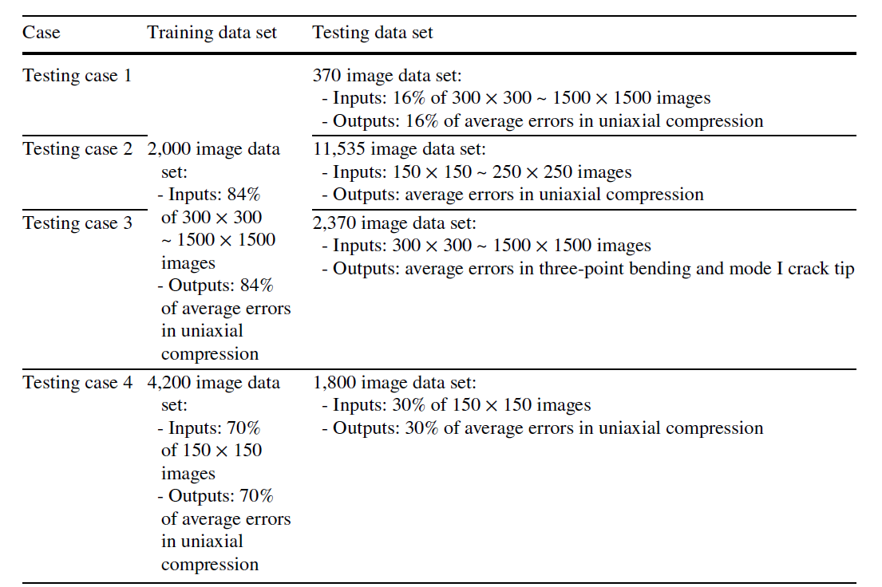
TRAINING DATA FOR CNN
Table. 1 Training and testing cases

Slide 10
RESULTS
Testing Case 1-
Testing Case 2-
Fig. 11&12 CNN prediction in relation with the target average errors

Slide 11
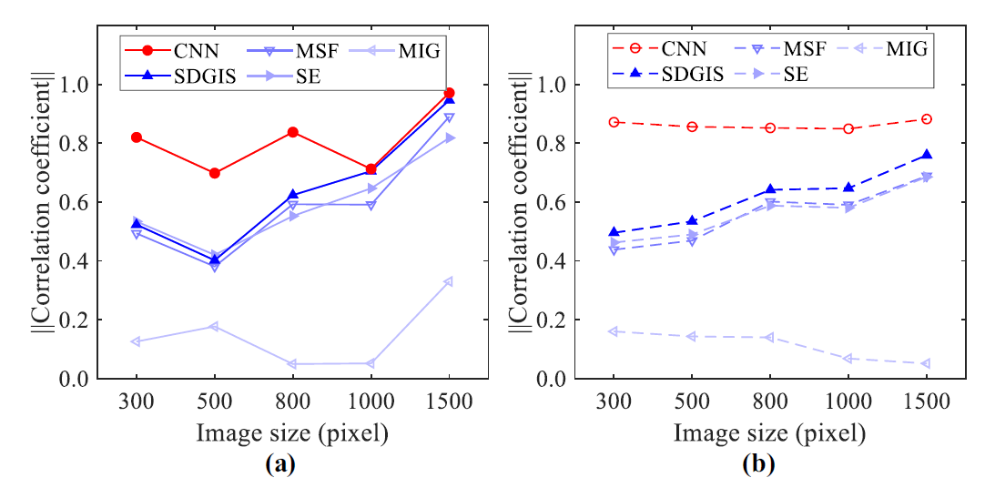
RESULTS
Fig.13 Correlation coefficient with respect to the image size using (a) the testing data and
(b) the entire data (testing and training data)

Slide 12
RESULTS
Testing Case 3-
Fig.15 (a) CNN prediction with TPB (2,370 testing data set), and
(b) CNN prediction with mode-I crack-tip (2,370 testing data set) deformation fields

Slide 13
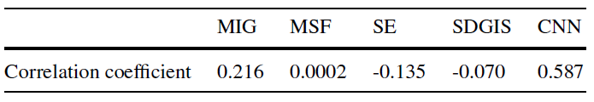
RESULTS
Testing Case 4-
Table 2. Comparison of correlation coefficients between existing
measures and CNN (150 × 150 images)
Fig.16 CNN prediction with 150 images

Slide 14
CONCLUSION
CNN model displayed better learning capability of speckle pattern than other metric.
They discovered that reducing the size of image more than a threshold can lead to errors, since it led to blurry images.
An online platform can be created so that various labs can upload their DIC images for better training and development of the CNN.
Can also infer that the CNN is bad at extrapolation, for smaller size images it is better to train the CNN only on smaller size images.

Slide 15
THANK YOU

